Slide 1
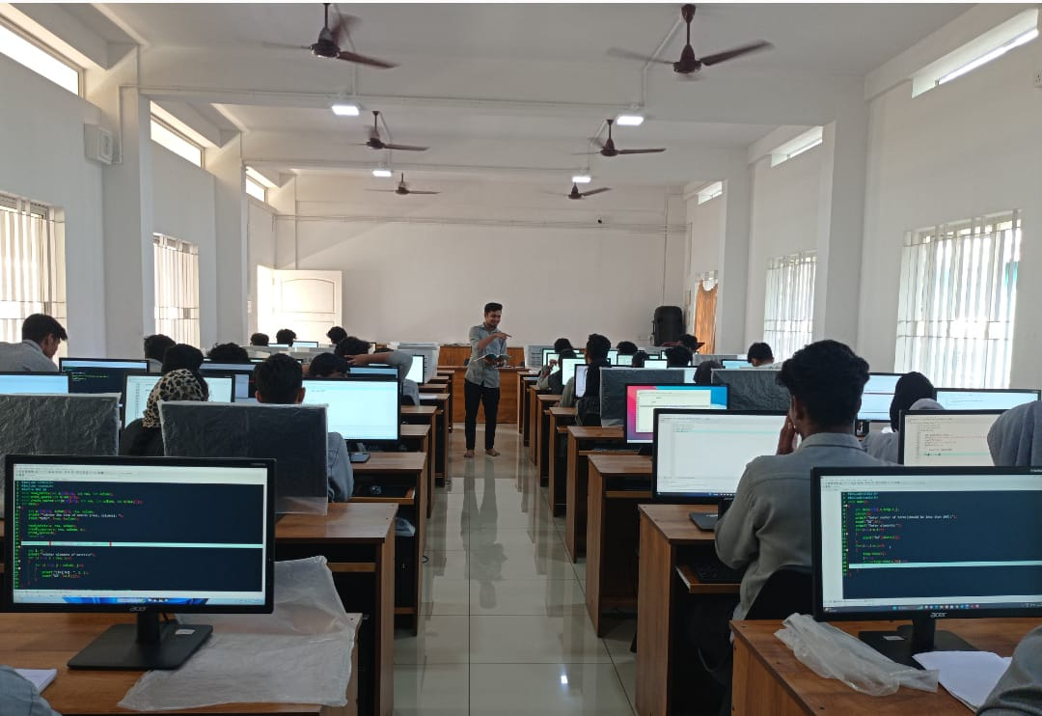
Peer Teaching

Slide 2
Mohammed Yaseen CM (2ND BCA) taking class on topic stack and queue and its algorithm implementation through program.

