Slide 1
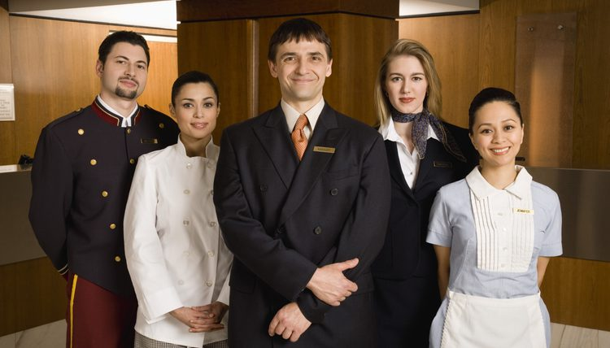
HOTEL DEPARTMENT
Asst. Prof Rasmin Mohd Ismail
B.VOC Tourism & Hospitality Department

Slide 2
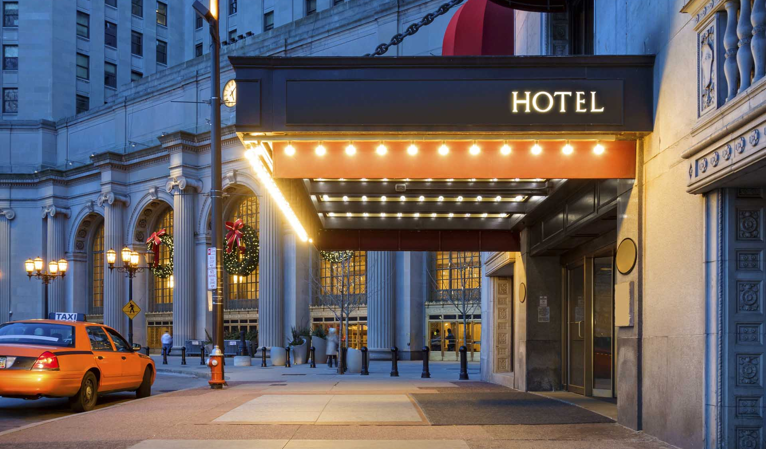
What is a Hotel?
A hotel means a place of boarding, a place for entertainment for travelers and public building in brief a Hotel is commercial establishment that provide accommodation, refreshment, meals & and have six licensed guest rooms.

Slide 3
OPERATIONAL DEPARTMENT (CORE DEPARTMENT)
Front office (revenue center)
Food Beverage service (revenue center)
Hotel operated shops (cost center)
Food production (kitchen) (cost center)
ADMINISTRATIVE DEPARTMENT (NON-CORE DEPARTMENT)
Maintenance department
Account department
Human resource department
Security department
Purchase department
Sales & marketing department
Revenue Center/
Non Revenue Center
Revenue center
Non-Revenue center

Slide 4
HOTEL DEPARTMENT
Front Office
Food & Beverage
Human Resource Management
Sales and marketing
Engineering & Maintenance
Room Division
Accounts
Purchase
Housekeeping
Kitchen
Security

Slide 5
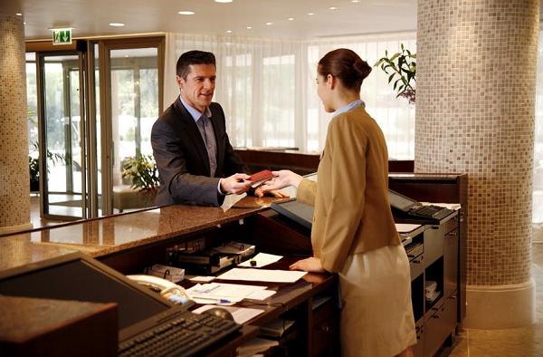
FRONT OFFICE
The front office is the nerve center of a hotel property. Communication and accounting are two of the most important functions of a front desk operation. The department includes:
Front Desk
Uniformed services
Concierges
Front Office Accounting System

Slide 6
FOOD & BEVERAGE
It is a department which serves food and beverage to the guest in a very attractive and pleasing manner, which creates good impression on the guest.
Restaurants
Bar/Coffee Shop
Banquets
Outdoor Catering

Slide 7
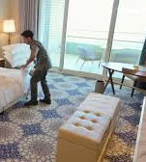
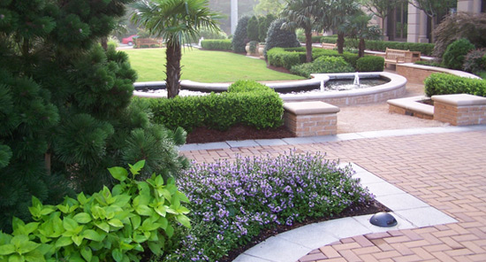
Housekeeping
This department is responsible for cleaning and maintaining hotel premises which include public area, guest rooms, lobby, swimming pool area etc. generally this department is not visible to the guest.
Laundry
Linen & Uniform room
Horticulture
Lost & Found section
Housekeeping Control Desk

Slide 8
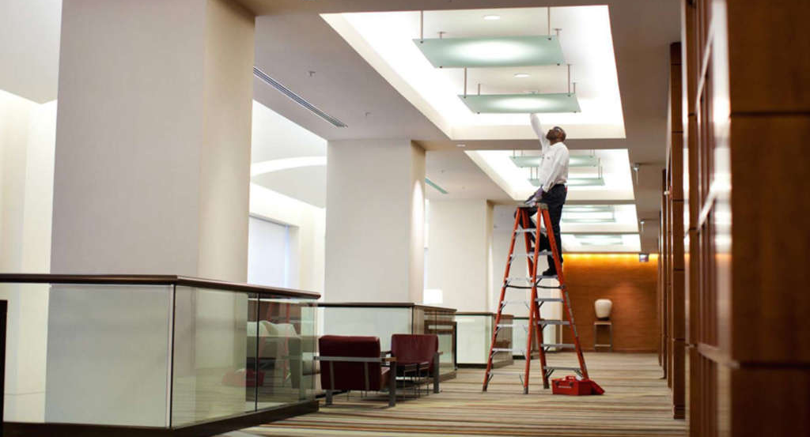
Maintenance &Engineering
As a hotel maintenance worker, your job duties are to inspect and repair various energy systems:
such as the heating and cooling systems, plumbing, lighting, and kitchen equipment.
To be responsible for smooth supply of electricity, water, and smooth function of air conditioning unit.

Slide 9
Account Department/Back office
This department is responsible for maintaining the financial statements and reports of the entire hotel. It is responsible for the calculations of the total pay profit or loss of the hotel.
Preparation of budget and allocation of revenue and expenditure for various departments
Collection of revenue from guests, companies etc.
Giving salaries to employees.
To keep check on the food & beverage cost.

Slide 10
Human Resource
This department is responsible for the Hiring and
firing of the staff, maintaining rules and regulations
of the hotel, providing uniform to the staff,
providing extra hands when required, Identity
cards for the staff, Training programmer etc.

Slide 11
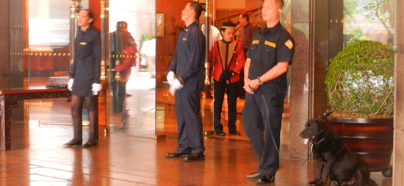
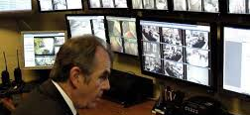
Security Department
This department works for maintaining the
safety and security of the guests, staffs and
the entire hotel properties.
Security department comes into action when
there is theft, fire, and any emergency cases.

Slide 12
Sales & Marketing
A manager will be responsible for coordinating marketing and
promotional activities to meet customer needs, working
closely with other Hotel staff to ensure customers are satisfied
with the facilities and their time there.
To make the brand image of hotel in the market.
To act as an agent for hotel and provide various information of changes

