Slide 1
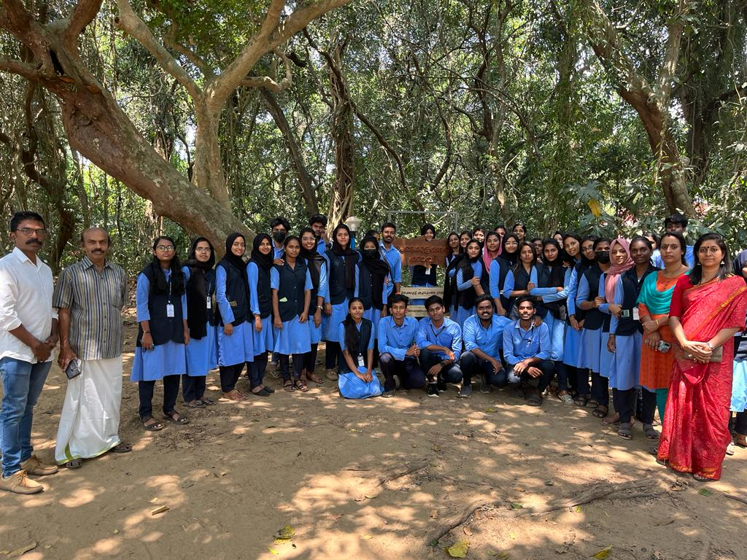
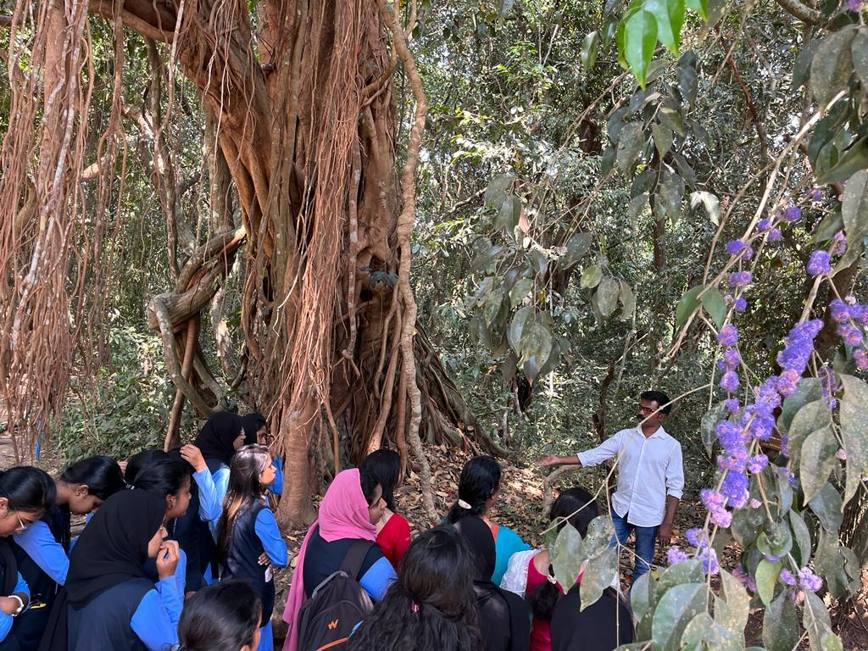
GREEN INITIATIVES A nature trip was conducted with the students to Sankhulangara Kav on 10th March 2023 at 10 am to give a class to the students about the need to maintain evergreen forests. The students touched Kavin, a miniature version of the forest. They understood the importance of survival of the Cavs.

