Slide 1
TEACHING METHOD
FARHANA NASER
ASST. PROFESSOR
DEPARTMENT OF PSYCHOLOGY

Slide 2
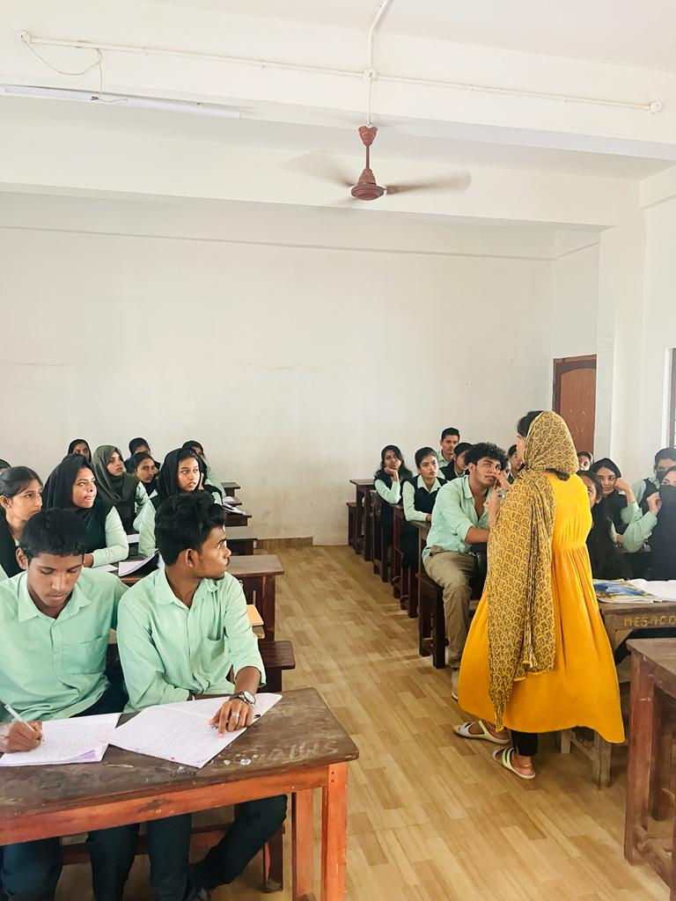
Group Learning/Discussion
STUDENTS DISCUSSION AND GROUP LEARNING ABOUT CURRENT ERA OF PSYCHOLOGY
The Discussion was moderated by the faculty were the current concepts was discussed and how the new Application in the field is associated with technology was projected in Discussion.
Collective Knowledge: The discussion allowed individual students to share their perspectives and insights, leading to a more comprehensive understanding of the current development in the field.
Expressive Communication: Participants learn to express their ideas clearly and concisely, improving their communication skills by contributing their perspective.
Active Listening: The discussion cultivated active listening skills, helping individuals better understand and respond to others' viewpoints.
Active Participation: The learning methods promote active participation, reducing the likelihood of disengagement.
Reflective Learning: The discussion provided opportunities for reflection on one's own understanding and learning process.
MAJOR AREAS DISCUSSED
Neuroscience Integration
Digital Mental Health
Positive Psychology
Cultural Psychology
Psychotherapy Innovations
WORLD MENTAL HEALTH DAY ASSOCIATED PROGRAM- 11/08/2023

Slide 3
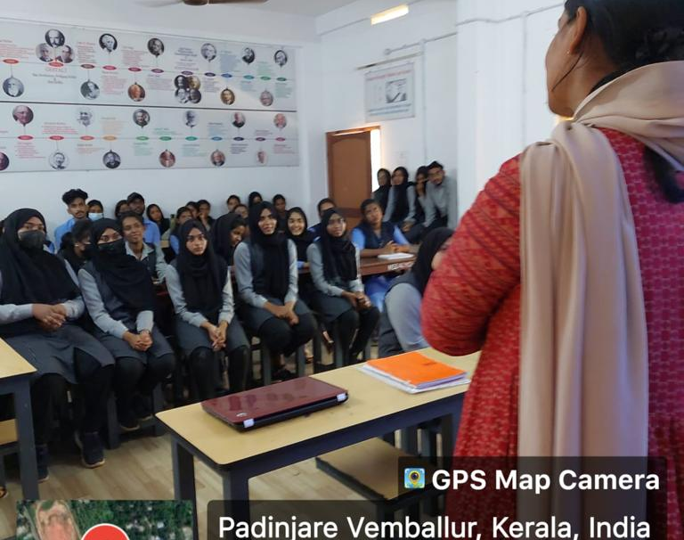
PRACTICAL DEMONSTRATION ASSESMENT OF EMOTION
Implementing an Emotional Assessment Program for undergraduate students. This method was conducted in Lab by using Practical Demonstration by using Tool to Assess the subject and Analyze the Emotional State of Subject.
MAJOR OBJECTIVES COVERED IN METHOD
Self-awareness
Goal Setting and Motivation
Critical Thinking Skills
Feedback Utilization
Assessment Techniques
Implementation of Objectives

Slide 4
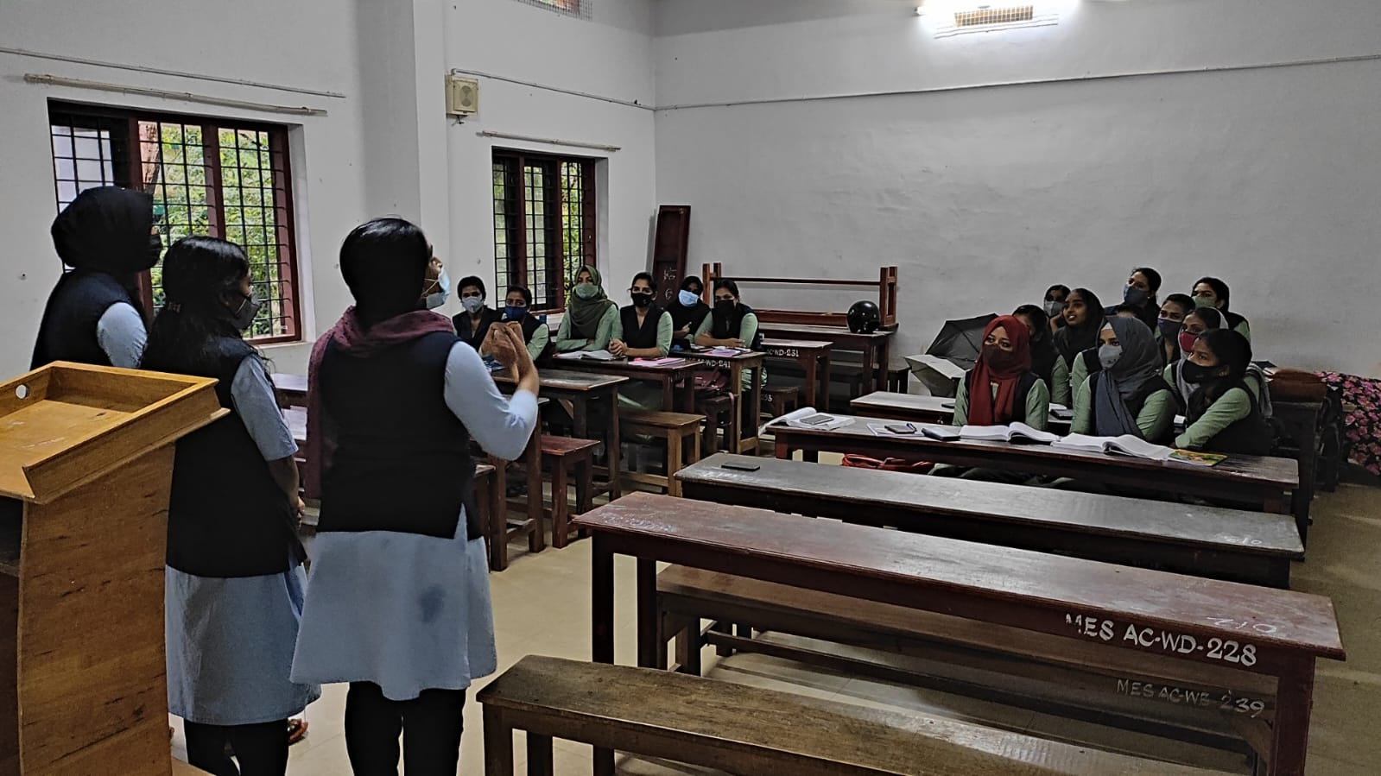
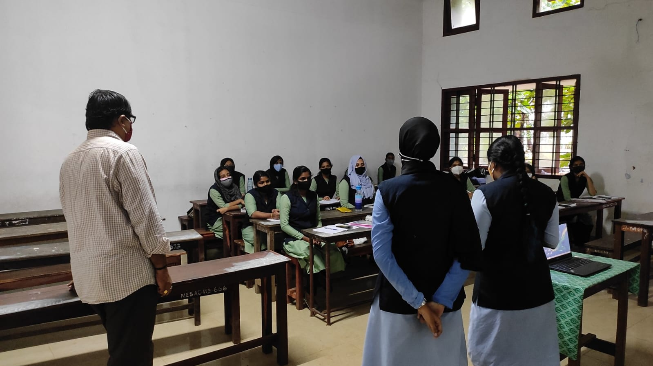
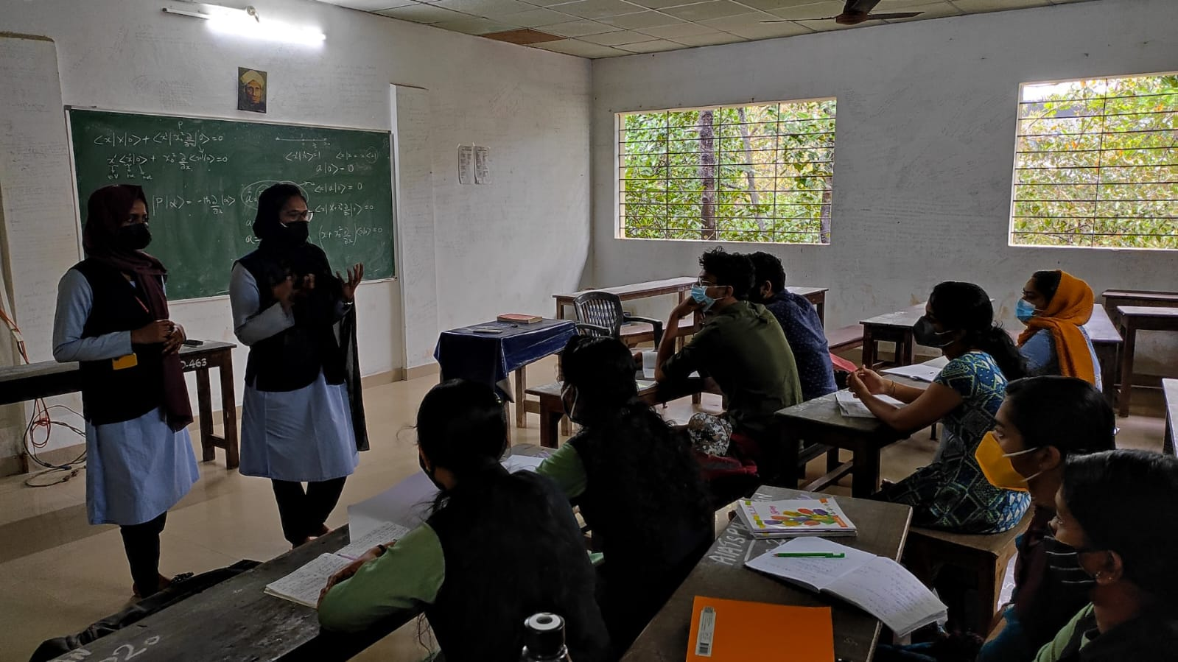
PEER TEACHING : LGBTQ+ AWARENESS
The primary aim of the peer teaching initiative was to raise awareness and foster inclusivity by empowering final-year students to educate their peers on LGBTQ+ issues, promoting understanding and acceptance within the student community
The peer teaching initiative significantly increased awareness and knowledge among students about LGBTQ+ identities, fostering a more informed and understanding campus community.
Empowered final-year students to take an active role in educating their peers, promoting a sense of responsibility and leadership in fostering positive change.

