Slide 1
Lecture using ppt

Slide 2
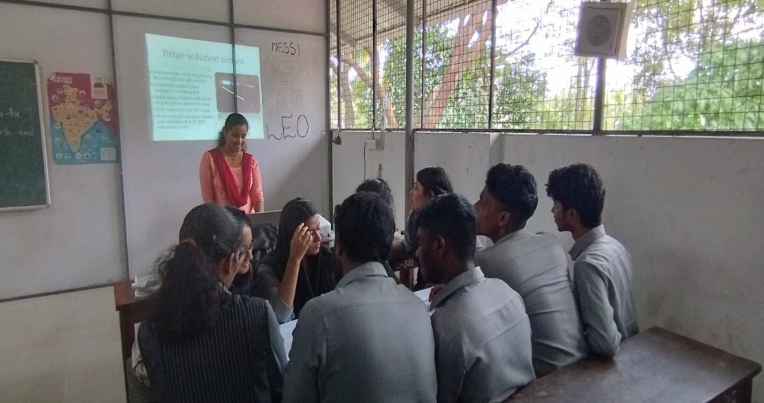
Second semester Topic: Fish Biochemistry and Spoilage
Studying fish biochemistry aids in ensuring product quality, safety, and sustainability in fish processing. It informs strategies to prevent spoilage, optimize processing, and develop innovative, economically viable products.
PowerPoint presentations enhance learning by combining visual and auditory elements, fostering engagement. Organized content, graphics, and multimedia aid comprehension, making complex topics more accessible and promoting effective teaching.

